Slide 1
QISKIT FALL FEST 2026 · TRACK 3 · LIVE DEMO
Team WCODERS
Watch a quantum error
get caught and fixed
Two live circuits in Quirk: the building blocks of the surface code our decoder protects
Demo 1 · Bit-flip code
Demo 2 · Phase-flip code

Slide 2
BEFORE WE START
How to read a Quirk circuit
Lines = qubits
Time → right
Dot + ⊕ = CNOT
Each horizontal wire is one qubit, numbered from the top.
Read the circuit left to right, like a sentence.
“If the dot’s qubit is 1, flip the ⊕ qubit.”
Sphere = Bloch
Meter = measure
Chance box
The qubit’s state drawn as an arrow. Same arrow = same information.
Reads a qubit out as 0 or 1. Used only on the alarm qubits.
The % chance a qubit reads 1. We want 0% at the end.
Quirk live demo · Tip: hover over any gate in Quirk to see what it does

Slide 3
THE CIRCUIT AT A GLANCE
5 qubits, 6 stages, left to right
Qubits 0, 1, 2 · data
Qubits 3, 4 · alarms
Together they hold ONE protected qubit of information.
Check qubits. They beep when neighbours disagree.
1
2
3
4
5
6
Prepare
Encode
Error
Alarms
Fix
Verify
set the information
spread over 3 qubits
noise hits a qubit
checks measured
decoder repairs
same arrow as start
Quirk live demo · Both demos follow these same 6 stages

Slide 4
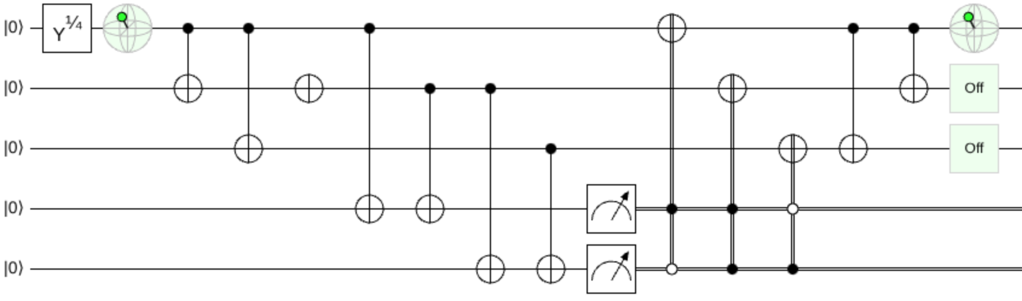
DEMO 1 · THE REAL CIRCUIT IN QUIRK
The 6 stages, as they appear on screen
1
2
3
4
5
6
1 Prepare · 2 Encode · 3 Error on qubit 1 · 4 Alarms · 5 Fix · 6 Verify: same arrow, “Off” = 0%
Quirk live demo · Actual screenshot of Demo 1, rendered in Quirk

Slide 5
DEMO 1 · BIT-FLIP CODE · STAGES 1–2
Prepare the information, then spread it
STAGE 1 · PREPARE
STAGE 2 · ENCODE
Point at: the first Bloch sphere on qubit 0.
Point at: the two CNOTs from qubit 0 to qubits 1 and 2.
“This arrow is our information. Remember where it points.”
“We spread it over 3 qubits: one logical qubit on three physical ones, like our 13.”
If a judge asks “isn’t copying impossible?” The CNOTs don’t copy the state; they entangle the 3 qubits so the information is shared.
Quirk live demo · Demo 1 open in its own tab

Slide 6
DEMO 1 · BIT-FLIP CODE · STAGES 3–4
An error hits, and the alarms point to it
Alarm pattern → which qubit broke
STAGE 3 · ERROR
Point at: the lone X on qubit 1. “Noise flips qubit 1.”
Alarm 3 | Alarm 4 | Meaning
0 | 0 | no error, do nothing
1 | 0 | qubit 0 flipped
1 | 1 | qubit 1 flipped (our demo)
0 | 1 | qubit 2 flipped
STAGE 4 · ALARMS
Point at: the CNOTs down to qubits 3 and 4, then the meters. “Each alarm asks: do my two neighbours agree?”
Alarm 3 compares qubits 0 and 1. Alarm 4 compares qubits 1 and 2.
Quirk live demo · The alarm pattern is called the syndrome

Slide 7
DEMO 1 · BIT-FLIP CODE · STAGES 5–6
The decoder repairs it, and we check
STAGE 5 · FIX (THE DECODER)
STAGE 6 · VERIFY
Point at: the three X gates with dots and circles under them.
Point at: the last Bloch sphere and the two Chance boxes.
Filled dot = “if this alarm is 1”. Hollow circle = “if it is 0”. Each X fires only for its pattern from the table.
Same arrow as stage 1. Chance boxes at 0%. The information survived the error.
Here the decoder is a 4-row lookup table. That only works because there are 2 alarms.
Quirk live demo · Remember this lookup table: it comes back on the scaling slide

Slide 8
DEMO 1 · DO THESE LIVE
Three moves that prove it works
MOVE A
MOVE B
MOVE C
Move the error
Remove the error
Break it: two errors
Drag the error X from qubit 1 up to qubit 0, then down to qubit 2.
Drag the error X off the circuit into empty space. Ctrl+Z brings it back.
From the toolbox (“Half Turns”), drag a second X onto qubit 0 or 2, in the error’s column.
Result: different alarms, still fixed.
Result: no alarms, nothing changed.
Result: final arrow is wrong. Too small a code.
Quirk live demo · If anything goes wrong: Ctrl+Z, or click the demo link again to reset

Slide 9
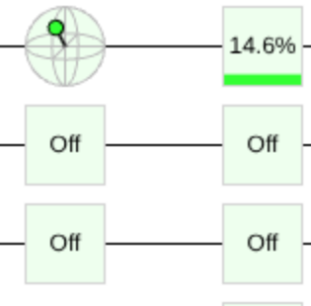
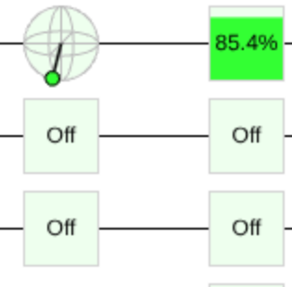
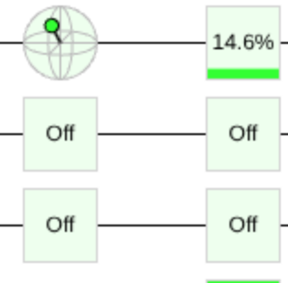
DEMO 1 · WHAT STAGE 6 SHOWS AFTER EACH MOVE
One error is always fixed. Two errors break it.
As loaded: error on qubit 1
Move A: error on qubit 0
Move B: no error
Move C: two errors
Unchanged. No alarms, no fix
Broken. Arrow flipped, 85.4%
Fixed. Arrow matches, 14.6%
Fixed. Different alarms, same result
Quirk live demo · Actual Quirk screenshots of the final check (Bloch sphere, then Chance %)

Slide 10
DEMO 2 · PHASE-FLIP CODE
A phase-flip, caught the same way
WHAT IS DIFFERENT
THE ONE IDEA
Point at: the Z gate on qubit 1, the error, and the rows of H gates on both sides of it.
H gates turn a phase-flip into a bit-flip, so the same alarms catch it.
Everything else is the same 6 stages as Demo 1: same alarms, same decoder, same final check.
Do live: drag the Z between qubits 0, 1 and 2. Still fixed every time.
Link to our project: the surface code needs both. Its Z-checks catch bit-flips (Demo 1) and its X-checks catch phase-flips (Demo 2).
Quirk live demo · Demo 2 open in its own tab

Slide 11
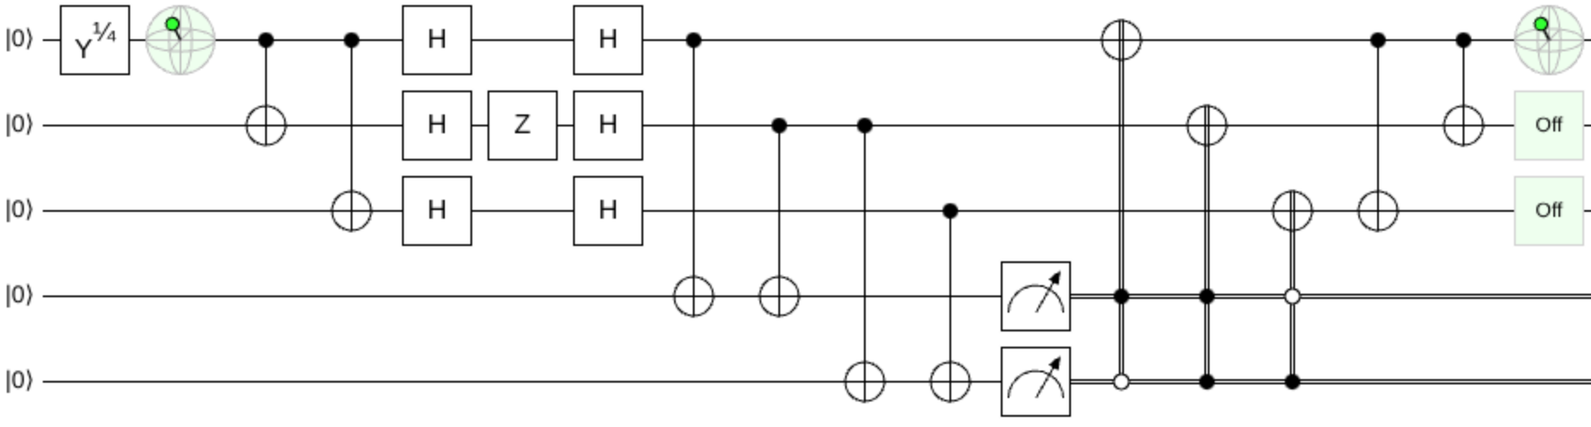
DEMO 2 · THE REAL CIRCUIT IN QUIRK
Same 6 stages, H gates around the error
1
2
3 · H Z H
4
5
6
3 The H gates turn the Z (phase-flip) into an X (bit-flip). Stages 4–6 are identical to Demo 1, and the final arrow matches again.
Quirk live demo · Actual screenshot of Demo 2, rendered in Quirk

Slide 12
WHY THIS NEEDS OUR DECODER
A lookup table stops working fast
Quirk demo · 2 alarms
Our d=3 surface code · 12 alarms
d=5 surface code · 40 alarms
4
4,096
2⁴⁰
alarm patterns. A lookup table is enough.
alarm patterns, plus erasures and 10:1 biased noise.
about 1 trillion patterns. Impossible to list.
Our tensor-network decoder sums every case without listing them, and matches brute force to 10⁻¹⁴.
Quirk live demo · Next: our tensor-network decoder results

Slide 13
TRY IT YOURSELF
Both circuits, one click away
DEMO 1
DEMO 2
Bit-flip code ↗
Phase-flip code ↗
Catches X errors, like the surface code’s Z-checks.
Catches Z errors, like the surface code’s X-checks.
Free, runs in any browser, nothing to install. Open both in separate tabs before presenting.
Quirk by Craig Gidney · algassert.com/quirk

